Slide 1


Characterization 1
Character Traits
© 2025 Geoffrey James Aguirre. All Rights Reserved.

Slide 2
Characterization 1 | Videos

Slide 3
Characterization 1: True Traits (versus Impostor Traits)

Slide 4
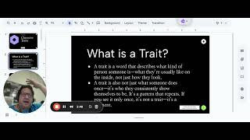

Slide 5
Mr. A Reads Little Red-Riding-Hooded Wolf

Slide 6
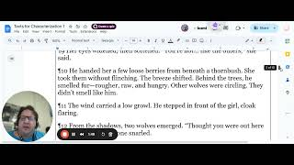

Slide 7
Wolfzel and Growltel - Part 1 (Locating Possible Traits and Recording Textual Evidence)

Slide 8
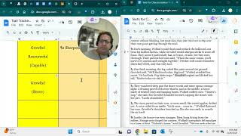

Slide 9
Wolfzel and Growltel - Part 2 (Analyzing Possible Traits; Determining Which Are True Traits)

Slide 10
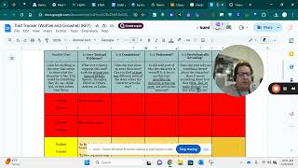

Slide 11
Characterization 1

Slide 12
What is a Trait?
A trait is a word that describes what kind of person someone is—what they’re usually like on the inside, not just how they look.
A trait is also not just what someone does once—it’s who they consistently show themselves to be. It’s a pattern that repeats. If you see it only once, it’s not a trait—it’s a moment.
© 2025 Geoffrey James Aguirre. All Rights Reserved.

Slide 13
Consistent – It shows up across time or in more than one situation.
A trait is:
Patterned – It reflects a tendency in how the character typically thinks, feels, or behaves.
Evidence-Based – It can be supported by observable examples (speech,thoughts, actions, and so on).
Psychologically Revealing – It gives insight into what kind of person the character is.
01
02
03
04
© 2025 Geoffrey James Aguirre. All Rights Reserved.

Slide 14
Impostors = Almost a trait, but fails when tested
Confusers = Not traits at all (even if they seem like it)
© 2025 Geoffrey James Aguirre. All Rights Reserved.

Slide 15

Consistent – It shows up across time or in more than one situation.
A trait impostor
. . .
Patterned – It reflects a tendency in how the character typically thinks, feels, or behaves.
Evidence-Based – It can be supported by observable examples (speech,thoughts, actions, and so on).
Psychologically Revealing – It gives insight into what kind of person the character is.
. . . fails one or more parts of the test.
01
02
03
04
© 2025 Geoffrey James Aguirre. All Rights Reserved.
Notes:
They often look like traits, use trait-language, and may even appear in trait lists.

Slide 16
A trait confuser . . .
. . . is a category of character description that students often mistake for traits, but they never qualify on their own.
They don’t even make it to the “test” phase unless misunderstood.
01
02
03
04
© 2025 Geoffrey James Aguirre. All Rights Reserved.

Slide 17
Roles/Labels (“leader,” “the smart one,” “best friend”)
Trait confuser types
Skills/Talents (good memory, fast runner, good cook)
States of Being (tired, sick, cold, hungry)
(external, temporary, or shallow descriptions)
Emotions (angry, happy, nervous)
Situational Reactions (flinched once, ran once, yelled once)
© 2025 Geoffrey James Aguirre. All Rights Reserved.

Slide 18
Consistent – It shows up across time or in more than one situation.
A trait is:
Patterned – It reflects a tendency in how the character typically thinks, feels, or behaves.
Evidence-Based – It can be supported by observable examples (speech,thoughts, actions, and so on).
Psychologically Revealing – It gives insight into what kind of person the character is.
01
02
03
04
© 2025 Geoffrey James Aguirre. All Rights Reserved.

Slide 19
Look for anything in the story that seems to show what the character is like. Something:
they do;
they say;
they think;
they feel; or
how others treat them or feel about them.
© 2025 Geoffrey James Aguirre. All Rights Reserved.

Slide 20
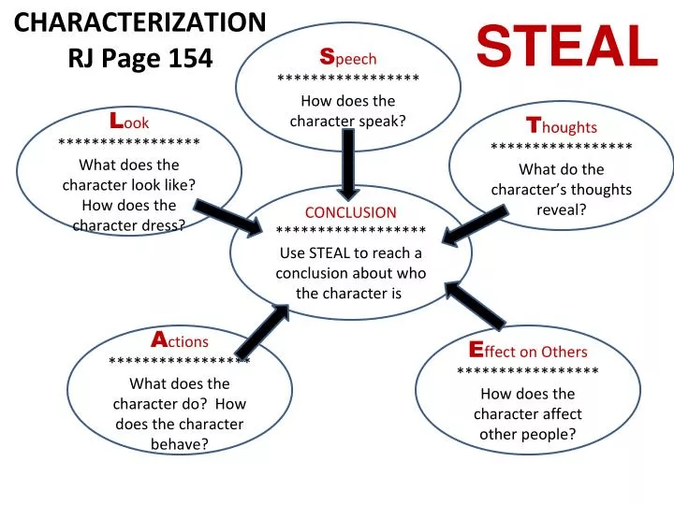
© 2025 Geoffrey James Aguirre. All Rights Reserved.

Slide 21

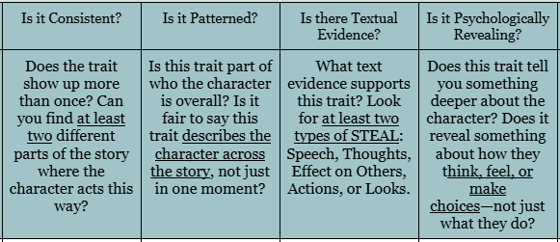
Consistent – It shows up across time or in more than one situation.
Patterned – It reflects a tendency in how the character typically thinks, feels, or behaves.
Evidence-Based – It can be supported by observable examples (speech,thoughts, actions, and so on).
Psychologically Revealing – It gives insight into what kind of person the character is.
01
01
02
02
03
03
04
04
© 2025 Geoffrey James Aguirre. All Rights Reserved.

Slide 22
© 2025 Geoffrey James Aguirre. All Rights Reserved.

Slide 23
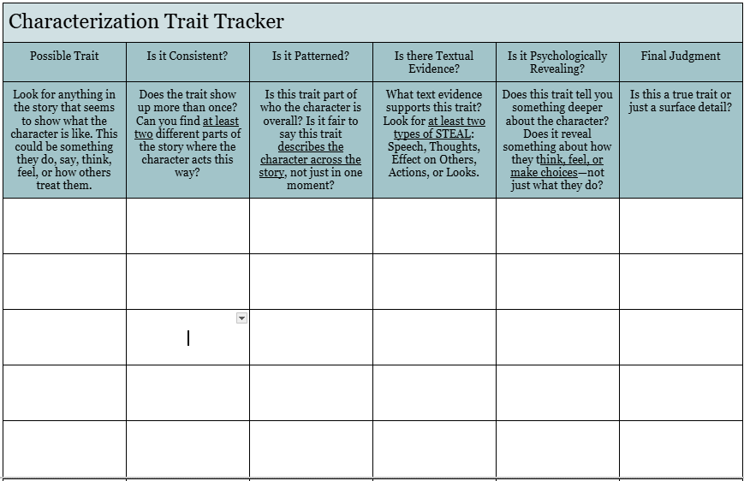
01
02
03
04
© 2025 Geoffrey James Aguirre. All Rights Reserved.

Slide 24

Little Red-Riding-Hooded Wolf
They used to call him Strange Tooth behind his back, but his grandmother always said it plainly: “You’re a perceptive little wolf. You don’t just see things—you notice what others miss.”
From the time he was a cub, he’d observed what others rushed past. He noticed which birds called in warning, which trees bent the wrong way in the wind. He knew the scent of fear, not just in prey, but in packmates who smiled too wide. The other wolves hunted by instinct. He hunted by patterns. And he had a pattern for everything.
Direct Characterization → What does Little Red-Riding-Hooded Wolf’s grandmother call him that suggests a possible trait?
© 2025 Geoffrey James Aguirre. All Rights Reserved.

Slide 25
Little Red-Riding-Hooded Wolf
Now older, cloaked in red to throw off hunters, he crept through the edge of the human village. The cape rustled when he passed the window of the baker’s house. The child inside froze. Her mouth smiled, but her eyes flicked once—twice—toward the bread knife.
She’s scared, he thought. But why would a child with a knife be afraid of a passing shadow?
He adjusted his hood to cover more of his muzzle. Maybe he still looked too much like what he was trying not to be.
Thoughts → What does the wolf notice about the girl’s reactions, and how does this reveal something about how he thinks?
Looks → How does the description of the wolf’s red cloak and hidden muzzle show how he wants others to see him—and how he sees himself?
© 2025 Geoffrey James Aguirre. All Rights Reserved.

Slide 26
Little Red-Riding-Hooded Wolf
At the edge of the forest, he heard soft crying. A girl—no more than ten—stood next to a shattered basket of berries.
“I didn’t mean to drop them,” she whispered.
He crouched beside her. “You didn’t,” he said gently. “But someone scared you.”
Her eyes widened, then softened. “You’re not… like the others,” she said.
He handed her a few loose berries from beneath a thornbush. She took them without flinching. The breeze shifted. Behind the trees, he smelled fur—rougher, raw, and hungry. Other wolves were circling. They didn’t smell like him.
Speech → What do the wolf’s words to the girl tell us about the way he communicates and responds to others?
Effect on Others → How does the girl’s reaction to the wolf change over time, and what does this suggest about his influence on her?
© 2025 Geoffrey James Aguirre. All Rights Reserved.

Slide 27
Little Red-Riding-Hooded Wolf
The wind carried a low growl. He stepped in front of the girl, cloak flaring.
From the shadows, two wolves emerged. “Thought you were out here playing forest fairy,” one snarled.
“Wearing red like prey,” snarled the other.
Strange Tooth didn’t growl back. Instead, he locked eyes with them and said, “Leave her alone.”
When they lunged, he moved—not with rage, but with precision. He didn’t bite. He ducked. He dodged. He used their momentum against them. And when the girl screamed, they hesitated. In that moment, he stood between them and their hunger—and they ran.
Action → When danger appears, what does the wolf do, and how is that different from what we might expect from a wolf?
© 2025 Geoffrey James Aguirre. All Rights Reserved.

Slide 28
Little Red-Riding-Hooded Wolf
Afterward, the girl held his paw. “Why didn’t you fight like a real wolf?” she asked.
He looked at the broken trail, the silence in the trees. “Because being perceptive isn’t about seeing everything,” he said, “It’s about knowing what matters.”
As they walked back toward the village, she didn’t let go. The cloak, for once, didn’t feel like a disguise. It felt like choice. The kind a wolf could make—when he finally saw himself clearly.
Resolution → At the end of the story, how does the wolf’s way of seeing the world—and himself—seem to have changed?
Trait Evolution → What does the shift from passive observer to intentional protector suggest about the kind of character he becomes by the end?
© 2025 Geoffrey James Aguirre. All Rights Reserved.

Slide 29
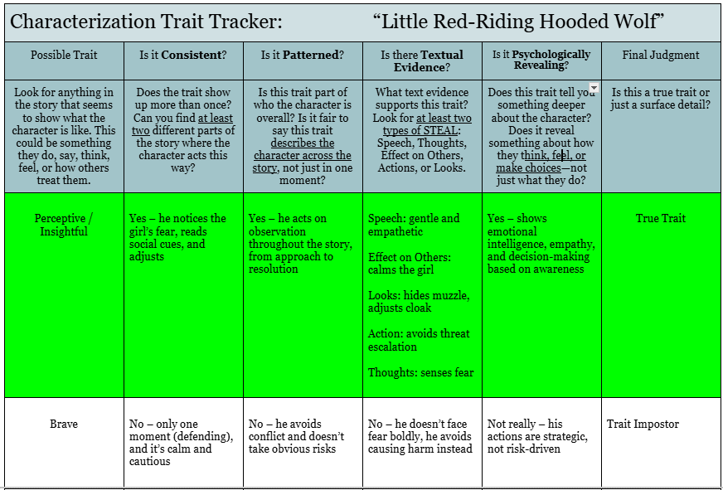
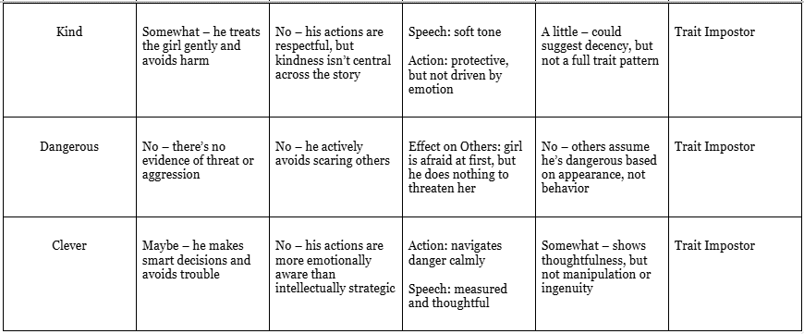
01
02
03
04
© 2025 Geoffrey James Aguirre. All Rights Reserved.

Slide 30
01
02
03
04
© 2025 Geoffrey James Aguirre. All Rights Reserved.

Slide 31
Direct Characterization: Grandmother directly states “You’re a perceptive little wolf.”
Check Your Answers
Thoughts: The wolf reflects, revealing he’s aware of fear and body language.
Looks: His red cloak and muzzle detail give insight into how others perceive him—and how he masks himself.
Speech: His kind words show calm and insight.
Effect on Others: The girl’s fear turns to trust—her response shows his calming presence.
Action: The wolf defends with strategy and self-control rather than aggression.
Resolution: The wolf still perceives—but now, with purpose.
Trait Evolution: From passive observer → intentional protector. His insight isn’t just analytical—it’s ethical and self-defined.
01
02
03
04
05
© 2025 Geoffrey James Aguirre. All Rights Reserved.

Slide 32
Five Categories of Traits
Personality Traits – emotional/psychological patterns (brave, insecure, optimistic)
Moral/Ethical Traits – values and conscience (honest, cruel, just)
Social/Relational Traits – how characters relate to others (shy, controlling, nurturing)
Behavioral Traits – consistent, meaningful tendencies (impulsive, methodical, restless)
Cognitive Traits – thinking habits or intellectual tendencies (naïve, analytical, rigid, insightful)
© 2025 Geoffrey James Aguirre. All Rights Reserved.

Slide 33
Core Trait Categories
Trait Type | Definition | Core Examples
Personality | Enduring emotional or psychological tendencies | Brave, insecure, optimistic, anxious, curious, moody
Moral/Ethical | Internal sense of right and wrong, value-driven behaviors | Honest, loyal, cruel, compassionate, deceitful, forgiving
Social/Relational | Patterns in how the character interacts with others | Friendly, manipulative, shy, protective, domineering, jealous
Behavioral | Consistent patterns in how a character acts or reacts in situations | Impulsive, cautious, controlling, patient, methodical
Cognitive | Habits of thinking, perceiving, or reasoning | Analytical, naïve, rigid, insightful, open-minded, gullible
© 2025 Geoffrey James Aguirre. All Rights Reserved.

